Slide 1


Smart Traffic Management for
Urban Congestion
Theme: Smart Automation / Urban Development
Team Name: 4-i-gen
Category: Software

Slide 2

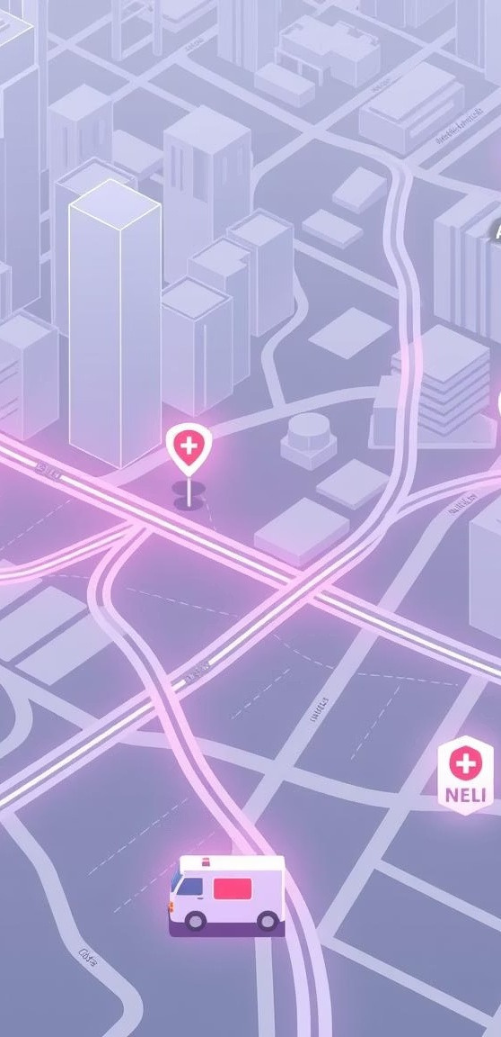
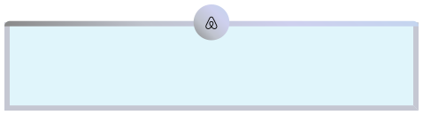

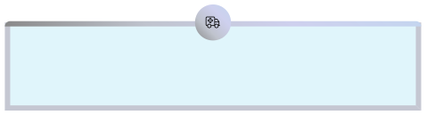

Smart Traffic & Emergency
Management System
AI-powered Traffic Optimisation
Dynamic signal control
Real-time Accident Detection
YOLO model integration
Green Corridors for EMS
Prioritised ambulance routes
Automated Emergency Alerts
Hospital & police notifications

Slide 3
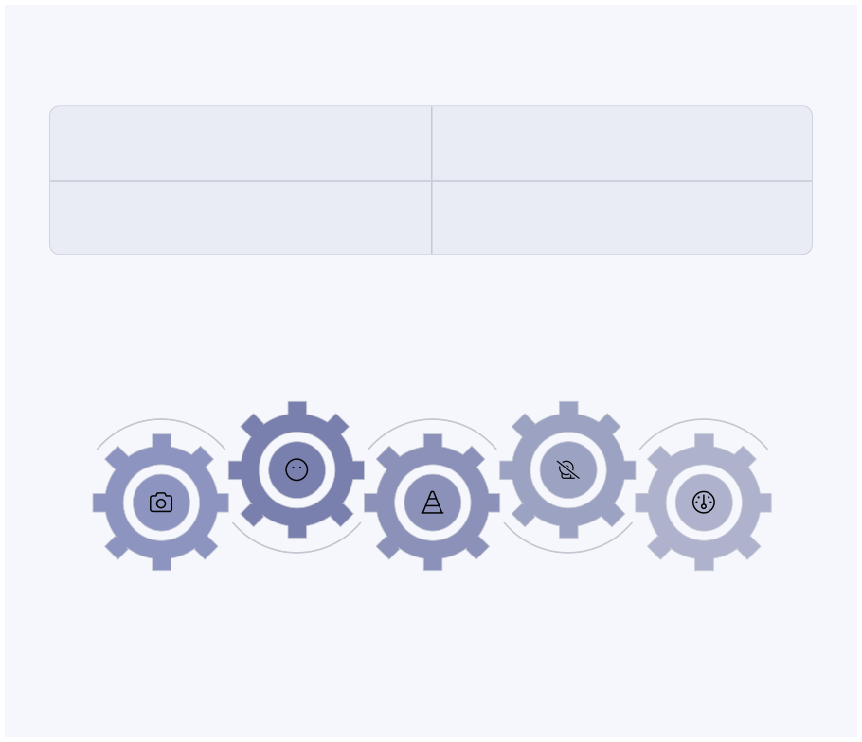

Technical Approach
AI/ML Stack
Simulation
Python,TensorFlow, OpenCV, YOLO
SUMO Traffic Simulator
Backend
Frontend
FastAPI,PostgreSQL, Redis
React.js Dashboard
AI Engine
Emergency Alerts
Process frameswithML
incidents
Trigger notifications for
models and analytics
Cameras & IoT
Signal Control
Central Dashboard
Collectreal-timesensorand
Adjusttraffic signalsvia control APIs
Visualize statusand
video feeds
historical insights

Slide 4


Feasibility & Viability
Feasibility
Risks
Solutions
Leverages existing
High data
processing demands
Hardware acquisition
costs
IoT device reliability
Edge computingfor
CCTV/IoT
local processing
Phased pilot testing
infrastructure
Scalable, cloud-
ready architecture
Hybrid server
infrastructure

Slide 5
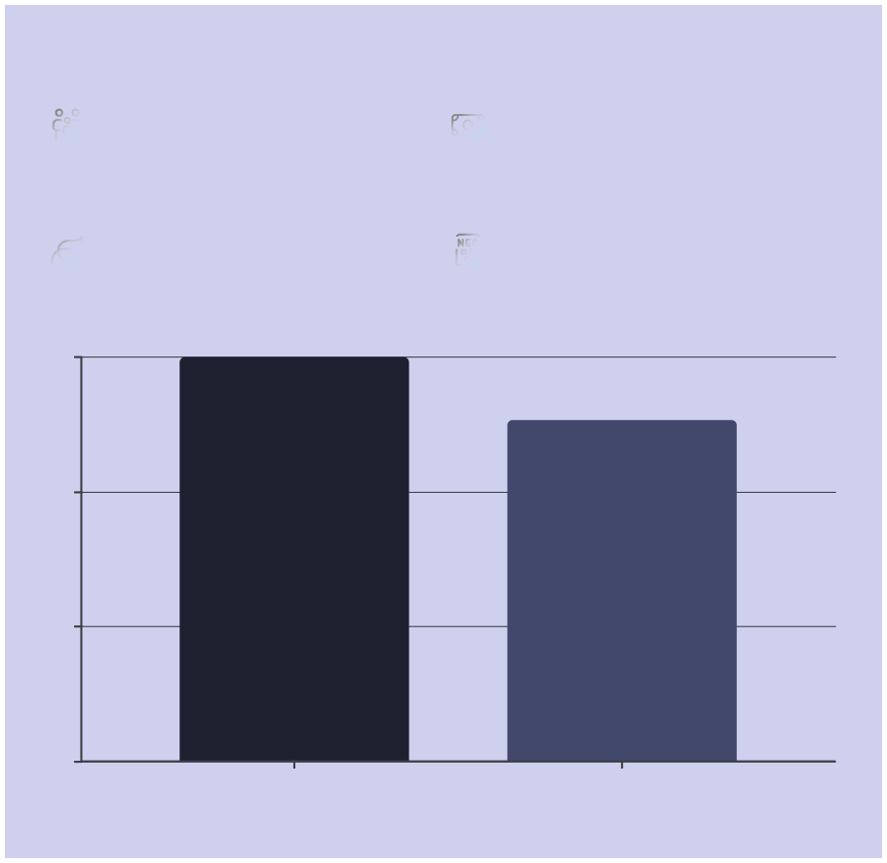

Impact & Benefits
Social Impact
Economic Gains
Livessaved,enhanced safety
Reduced fuel & time costs
Environmental
Governance
Lower carbon emissions
Improvedinter-agency coordination
45
30
15
0
Before System
After System
Commute time reduced by 15%

Slide 6




Research & References
SUMO Traffic Simulator documentation YOLO v8 accident detection research papers Reinforcement Learning for traffic optimisation studies Government of India traffic accident data analysis

Slide 7
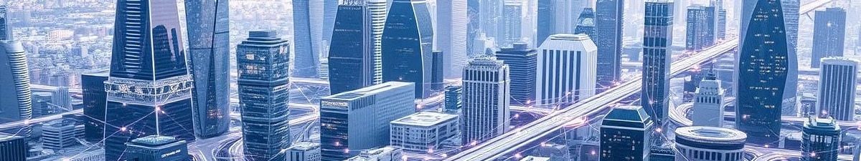
Why Our Solution Matters
"Smart urban infrastructureisn'tjustaboutefficiency;it'saboutsavinglivesandbuildingasustainable future for our cities."

Slide 8




Key Takeaways & Next
Steps
1
InnovativeApproach
AI-driven, real-time traffic & emergency management
2
Tangible Impact
Improved safety, economic benefits, environmental gains
3
Scalable & Feasible
Leverages existing tech, ready for pilot implementation
Join us in building smarter, safer Indian
cities!

Slide 9
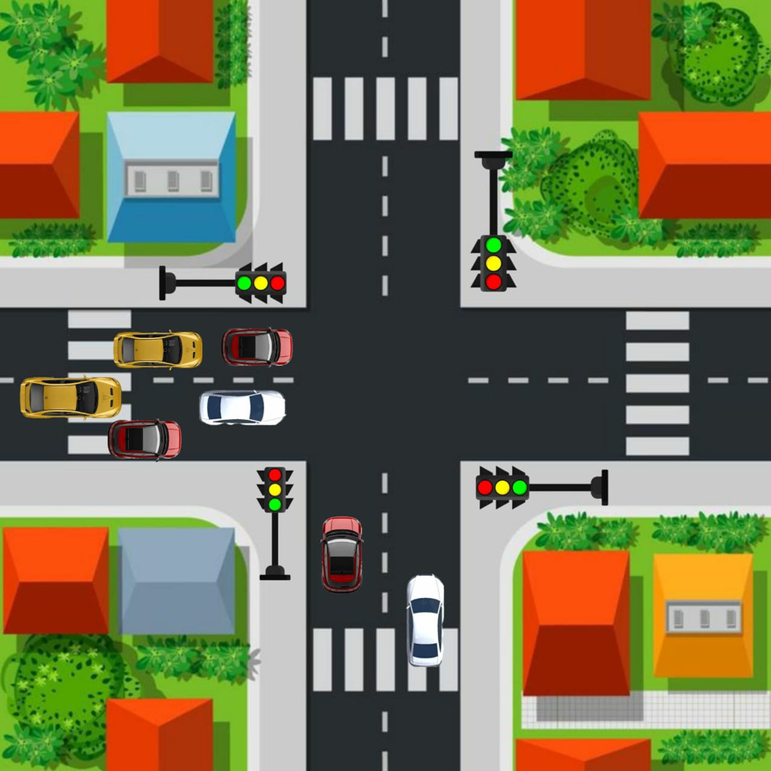

Slide 10
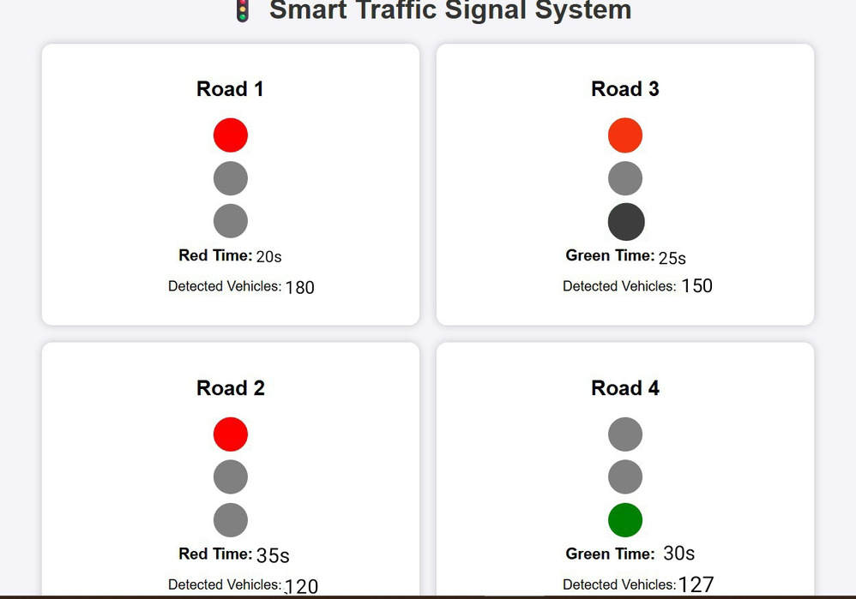
Prototype link : https://drive.google.com/file/d/1TEEN4ZpDk3QWOJIDqtKY3n54AR1867F8/view?usp=sharing

Slide 11
Thank You
Building smarter,safercitiestogetherforasustainableurban future.

